Slide 1



7. Blockchain Economics
Melanie Swan
Philosophy Department, Purdue University
melanie@BlockchainStudies.org
Slides: http://slideshare.net/LaBlogga

Slide 2







Melanie Swan, Technology Theorist
Philosophy and Economic Theory, Purdue University, Indiana, USA
Founder, Institute for Blockchain Studies
Singularity University Instructor; Institute for Ethics and Emerging Technology Affiliate Scholar; EDGE Essayist; FQXi Advisor
Economics and Financial Theory Leadership
Traditional Markets Background
New Economies research group
https://www.facebook.com/groups/NewEconomies
Source: http://www.melanieswan.com, http://blockchainstudies.org/NSNE.pdf, http://blockchainstudies.org/Metaphilosophy_CFP.pdf

Slide 3
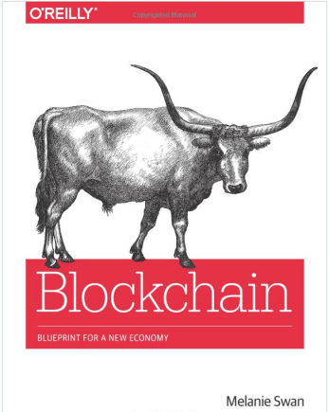

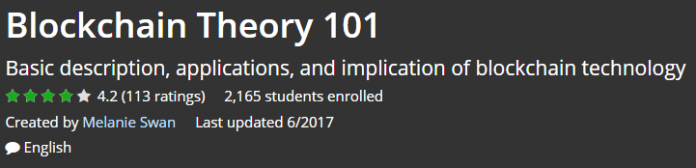

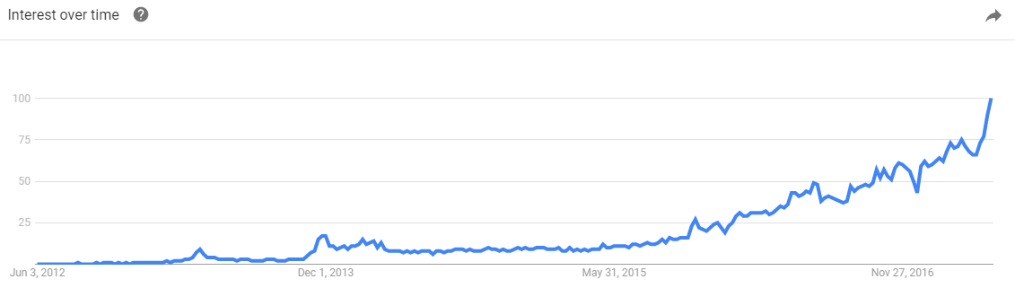

Blockchain
To inspire us to build this vision of the world
Source: http://www.amazon.com/Bitcoin-Blueprint-New-World-Currency/dp/1491920491

Slide 4

Agenda
Introduction
Technical Overview
Blockchain ICOs
Blockchain Economic Theory
Why do we need Blockchain?
Smart Network Convergence
Blockchain and Deep Learning

Slide 5

What is Blockchain/Distributed Ledger Tech?
Conceptual Definition:
Blockchain is a software protocol; just as SMTP is a protocol for sending email, blockchain is a protocol for sending money
Source: http://www.amazon.com/Bitcoin-Blueprint-New-World-Currency/dp/1491920491

Slide 6
What is Blockchain/Distributed Ledger Tech?
Technical Definition:
Blockchain is the tamper-resistant distributed ledger software underlying cryptocurrencies such as Bitcoin, for recording and transferring data and assets such as financial transactions and real estate titles, via the Internet without needing a third-party intermediary
Source: http://www.amazon.com/Bitcoin-Blueprint-New-World-Currency/dp/1491920491

Slide 7

Distributed Ledger Technology vs. Blockchain
Ledger: a file that keeps track of who owns what
Distributed Ledger (general form of DLT):
(1) shared transaction database among network members, (2) updated by consensus, (3) records timestamped with a unique cryptographic signature,
(4) in a tamper-proof auditable history all transactions
Blockchain (specific DLT w additional feature):
(5) Sequential updating of database records per chained cryptographic hash-linked blocks
Source: restatement of https://www.ibm.com/developerworks/cloud/library/cl-blockchain-basics-intro-bluemix-trs/index.html

Slide 8
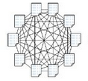
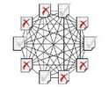
Public and Private Ledgers
Public: open to anyone (“permissionless”)
Identity unknown, for individuals
Ex: Zcash zero-knowledge proofs
Open access
Private: approved users (“permissioned”)
Identity known, for enterprise
Approved credentials
Controlled access
Any user
Financial Inst, Industry Consortia, Gov’t Agency
Examples:
Bitcoin
Ethereum
Examples:
R3
Hyperledger
Transactions logged on public Blockchains
Transactions logged on private Blockchains
Source: Adapted from https://www.linkedin.com/pulse/making-blockchain-safe-government-merged-mining-chains-tori-adams

Slide 9
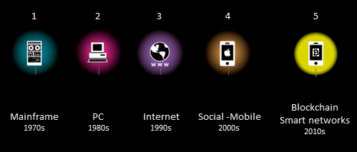
Context of the Blockchain Revolution
Blockchain is fundamentally the next phase of the Internet, not just a FinTech, could impact every industry
Two fundamental eras of network computing
I. Transfer Information
II. Transfer Value
Simple networks
Smart networks
6
7
2020s
2030s
Source: Expanded from Mark Sigal, http://radar.oreilly.com/2011/10/post-pc-revolution.html

Slide 10
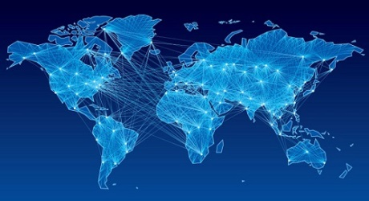
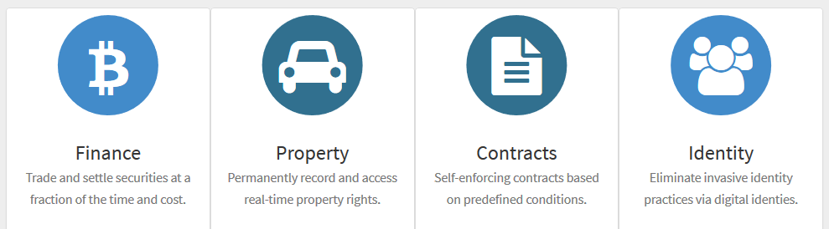
Four Kinds of Blockchain Applications
Money, Payments,
Financial Clearing
Smart Property Cryptographic Asset Registries
Smart Contracts
IP Registration
Identity Confirmation
Source: http://www.blockchaintechnologies.com

Slide 11
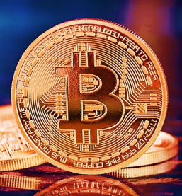
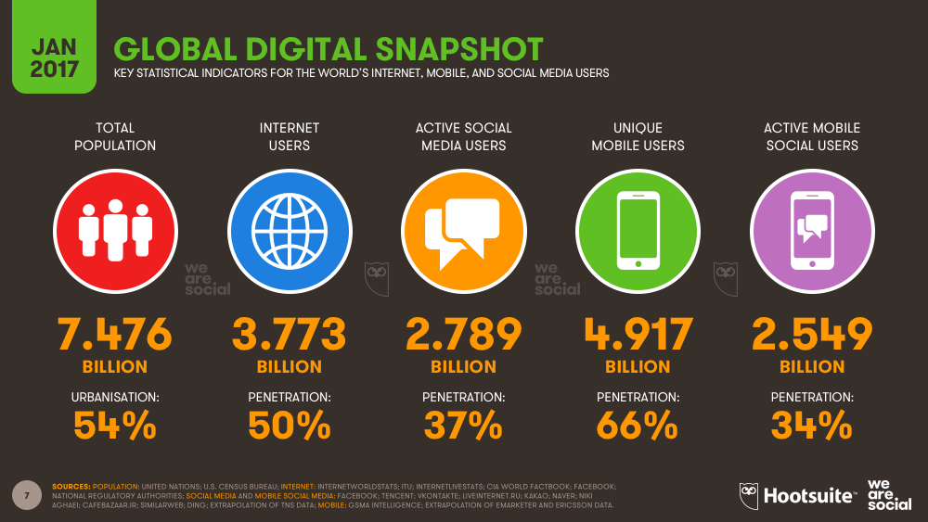
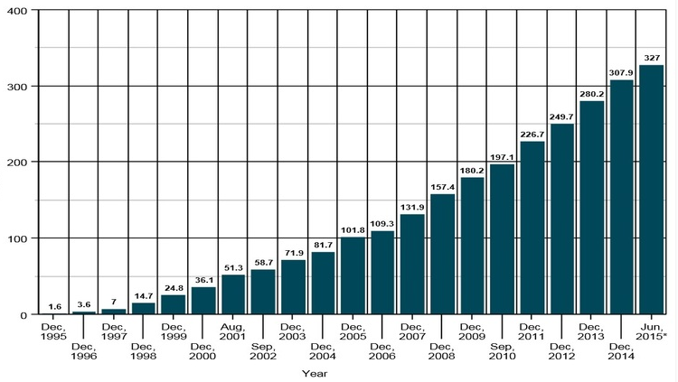
Slower Adoption than the Internet
Internet all over again, but since involves money and assets, likely to take longer
Information Internet: 20-40 years (50% online, corporate email)
Money Internet: could take longer (2050-2075)
More profound impact
Computationally-based society has less need for a brick-and-mortar institutional footprint
Growth in Global Internet users 1995-2015
Source: http://www.digital-marketing-course.org/growth-of-global-internet-users/, https://wearesocial-net.s3.amazonaws.com/uk/wp-content/uploads/sites/2/2017/01/Slide007.png

Slide 12

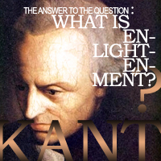



Crypto-enlightenment
At stake: redesign the only sectors not yet reinvented for the Internet era: Economics, Law, and Government
“One ought to think autonomously, free of the dictates of external authority” - Immanuel Kant
“Multiple private currencies should compete for customer business”
- Friedrich Hayek
Source: Kant, I. "Answering the Question: What Is Enlightenment?" (German: Beantwortung der Frage: Was ist Aufklärung?). 1784. Hayek, F. The De Nationalization of Money. 1976. (paraphrased)

Slide 13
Agenda
Introduction
Technical Overview
Blockchain ICOs
Blockchain Economic Theory
Why do we need Blockchain?
Smart Network Convergence
Blockchain and Deep Learning

Slide 14
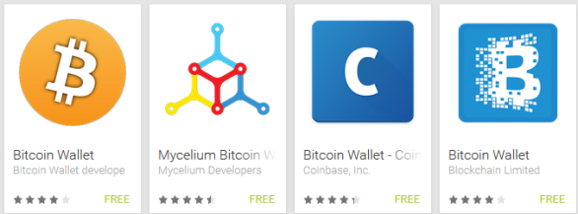
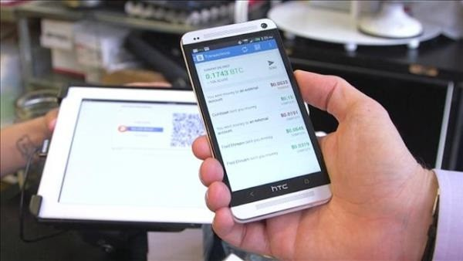
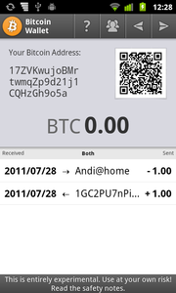
How does a blockchain work?
eWallet app: holds keys, not money
Using PKI (public key infrastructure): electronic wallet software issues a public-private key pair (public address is a 32-character alphanumeric code)
Scan public address (QR Code) & submit transaction
Private key confirms access and funds availability, transaction validated, executed & posted to blockchain

Slide 15


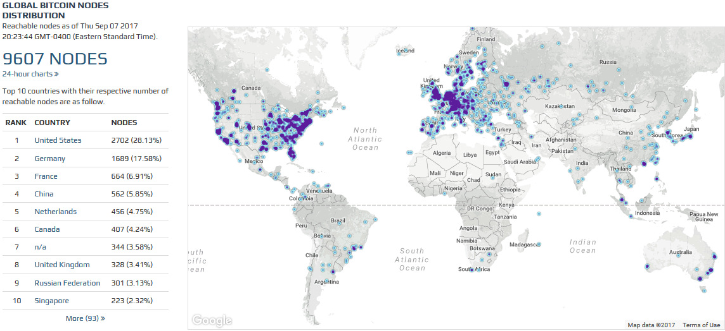
How robust is the p2p software network?
Run the software yourself:
9607 Global Nodes running full Bitcoind (9/17); 100 gb
p2p: peer to peer; Source: https://bitnodes.21.co, https://github.com/bitcoin/bitcoin

Slide 16
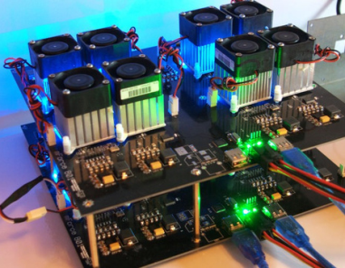
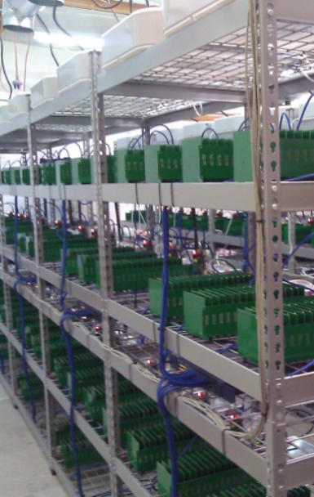
What is Bitcoin mining?
Run the software yourself:
Mining is the accounting function to record transactions, fee-based
Mining ASICs “find new blocks” (proof of work)
Network regularly issues random 32-bit nonces (numbers) per specified cryptographic parameters
Mining software constantly makes nonce guesses
At the rate of 2^32 (4 billion) hashes (guesses)/second
One machine at random guesses the 32-bit nonce
Winning machine confirms and records the transactions, and collects the rewards
All nodes confirm the transactions and append the new block to their copy of the distributed ledger
“Wasteful” effort deters malicious players
Fast because ASICs represent the hashing algorithm as hardware
Sample code:

Slide 17
Agenda
Introduction
Technical Overview
Blockchain ICOs
Blockchain Economic Theory
Why do we need Blockchain?
Smart Network Convergence
Blockchain and Deep Learning

Slide 18
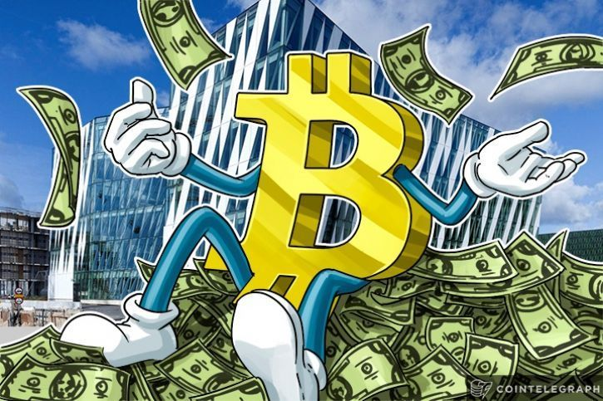
In the news: Blockchain ICOs
Source: https://cointelegraph.com/news/why-bitcoin-continues-to-be-on-the-top-of-its-game

Slide 19
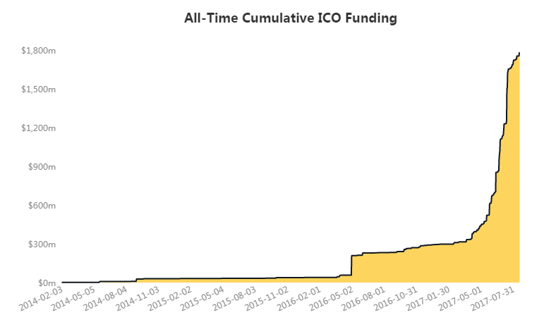


ICOs (Initial Coin Offerings)
ICO: fundraising method, more liquid than equity
Conceived as project finance / capital-budgeting solution
$1.74 bn cumulative ICO funding (Coindesk)
ICOs 4x size of VC funding 1H2017 (PitchBook)
ICOs: $1.3 bn, VC funding: $358 mn
Cumulative ICO Funding
2/3/14 - 7/31/17
Source: https://www.coindesk.com/ico-tracker

Slide 20

High-profile ICOs
Filecoin; $186 mn, Aug 2017
Registered (exempt) small offering CoinList (AngelList); Reg D 506(c)
Tezos $232 mn, Jul 2017
Brave, BATs (basic attention tokens), $35 mn, 30 seconds
Gnosis; $12.5 mn, Apr 2017
Self-regulating mechanisms
Known % of money supply in the ICO offering
Lock-up: No lock-up on ICO founders coins (usually 1 year IPO), could have time-lock-up
Source: http://www.amazon.com/Bitcoin-Blueprint-New-World-Currency/dp/1491920491

Slide 21

ICO Regulatory Stance
US: investor protection; regulated (Jul 2017)
ICOs and exchanges; what about smart contracts?
ICOs vs token sales (network utility) vs crowdfunding
Howey Test: is it a security?
Investment of money
Expectation of profits from the investment
The investment of money is in a common enterprise
Any profit comes from the efforts of a promoter or third party
UK: caveat emptor; safer if regulated, not regulated
China: banned, exchanges ordered to close (Sep 2017)
Russia: regulation expected by end 2017 (Sep 2017)
Gibraltar DLT Regulated Entities (to launch 2018)
Source: https://www.coindesk.com/ico-tracker, https://www.coindesk.com/china-outlaws-icos-financial-regulators-order-halt-token-trading/

Slide 22

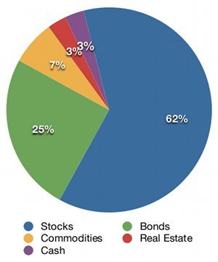
Bigger context of Institutional Markets
Global capital allocation to institutional investment-class products
Institutional exposure to cryptographic assets
Current value: $125 billion
Estimated value in 10 years: $2 trillion
Market becoming more institutional
ICO and exchanges: regulated entities
Cryptocurrency option approval
Institutional exchanges handling large customer orders ($20m+)
Genesis Trading, Cumberland Mining, Circle, Gemini Exchange, Project Omni
Source: https://bitcoinmagazine.com/articles/op-ed-blockchain-economy-ushering-new-world-economic-order, https://www.coindesk.com/standpoint-founder-bitcoin-asset-class-will-grow-2-trillion-market/

Slide 23
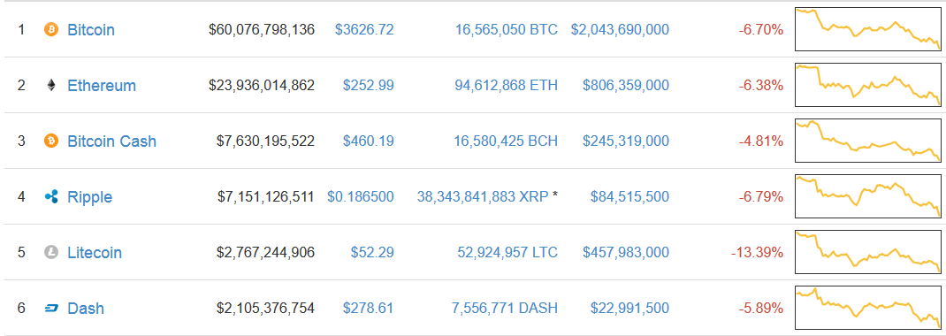
Cryptocurrency Market Capitalizations (9/17)
S&P 500: $22.2 tn; US GDP $18.8 tn
Crypto market cap: $125 bn (≃ top 60th of 200 countries)
Source: https://coinmarketcap.com, http://us.spindices.com/indices/equity/sp-500; List of countries by GDP (nominal) - Wikipedia

Slide 24
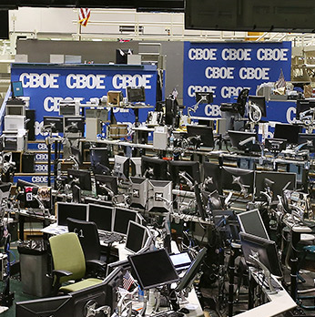
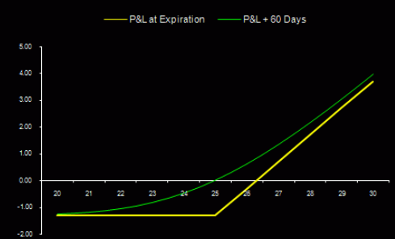

Cryptocurrency Options & Swaps
NY-based LedgerX: CFTC-regulated Swap Execution Facility (SEF) and Derivatives Clearing Organization (DCO)
Swap execution facility, clearing Bitcoin options
Sep 2017 began providing physically-settled put and call options and day-ahead swaps trading
Private trading for large customers
LedgerX options possibly to trade on the CBOE
Significance: cryptocurrency exposure in an institutional product, demand could be huge
Source: https://www.bloomberg.com/news/articles/2017-07-24/bitcoin-options-to-become-available-in-fall-after-cftc-approval

Slide 25
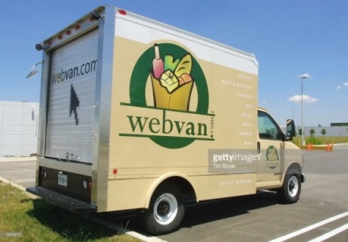
Investment Risk #1: Infrastructure Risk Blockchain Network Infrastructure Immature
Blockchain is a software protocol
Issue: no one wants to fund basic infrastructure build-out, but “shiny new” network apps will fail without it
Like the Dotcom Economy, the Blockchain Economy could have cycles of bubbles
Time lag before infrastructure is ready
Involves money so takes longer
Email
Bitcoin
Application Layer
TCP/IP, SMTP
Blockchain
Protocol Layer
Source: http://www.amazon.com/Bitcoin-Blueprint-New-World-Currency/dp/1491920491

Slide 26
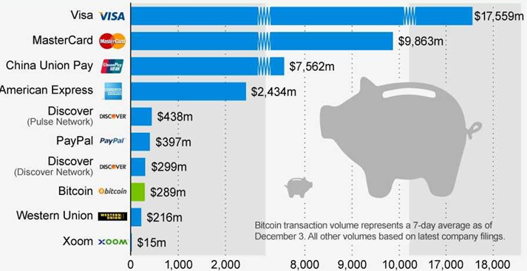
Investment Risk #2: Visa-class Processing Risk Bitcoin vs. other payment networks
Visa: 2,000 transactions/sec; Bitcoin: 7/sec
Visa: $18bn/day; Bitcoin: $300mn/day
Average transaction volume per second
Average daily transaction volume ($US mn)
1,667
7
Source: Statista / Coinmetrics, http://www.altcointoday.com/bitcoin-ethereum-vs-visa-paypal-transactions-per-second

Slide 27
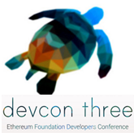
Investment Risk #2: Visa-class Processing Risk Consensus Algorithms (BFT)
Expect: diverse industry chains & consensus methods
Factom (HC billing), supply chain DLs (A/R financing coin)
Different levels of security: information, money, identity
Proof of Work
Bitcoin blockchain
Proof of Stake
Ethereum, Tezos, DFINITY, Tendermint/Cosmos, Stellar
Complicated scheme of tiered voting by staked participants
Worry: recreation of agent-based power structures?
Other “Proof of” solutions
Proof of Computational Completeness
Nov 2017
Source: BFT; Byzantine fault tolerance; https://www.slideshare.net/lablogga/blockchain-consensus-protocols

Slide 28
Agenda
Introduction
Technical Overview
Blockchain ICOs
Blockchain Economic Theory
Economic Transformation Story
Why do we need Blockchain?
Smart Network Convergence
Blockchain and Deep Learning

Slide 29

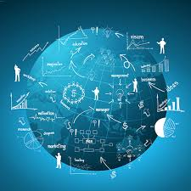


What is Economics?
Study of the production, distribution, and consumption of goods and services
Individual and group decision-making about goods and services and the consequences
Fundamental dynamics do not change
Wants are bigger than resources, cost of decision-making, opportunity cost, scarcity (material or intangible)
Same in all forms of economies
Classical Economics (material goods)
Network Economics (digital goods)
Smart Network Economics (automated smart contracts exchanging cryptographic assets)
Source: http://blockchainstudies.org/Blockchain_Economics_CFP.pdf

Slide 30
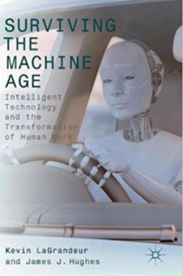

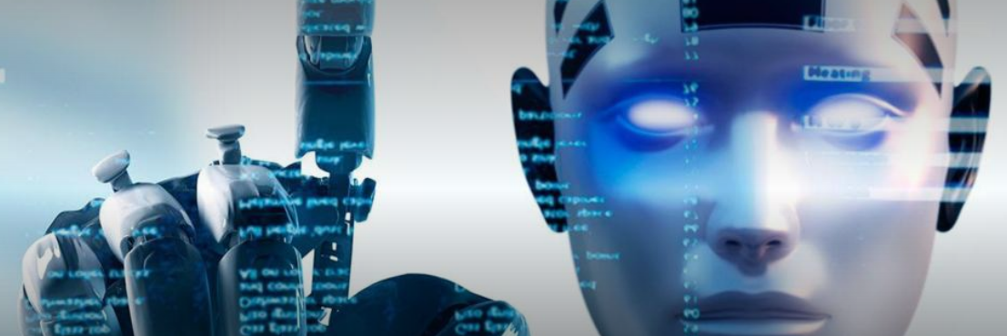
Technological Unemployment
Challenge: facilitate an orderly transition to Automation Economy
Half (47%) of employment is at risk of automation in the next two decades – Carl Frey, Oxford, 2015
Why are there still so many jobs in a world that could be automating more quickly? – David Autor, MIT, 2015
Source: Swan, M. (2017). Is Technological Unemployment Real? Abundance Economics. In Surviving the Machine Age: Intelligent Technology and the Transformation of Human Work. Hughes & LaGrandeur, Eds. London: Palgrave Macmillan. 19-33.

Slide 31
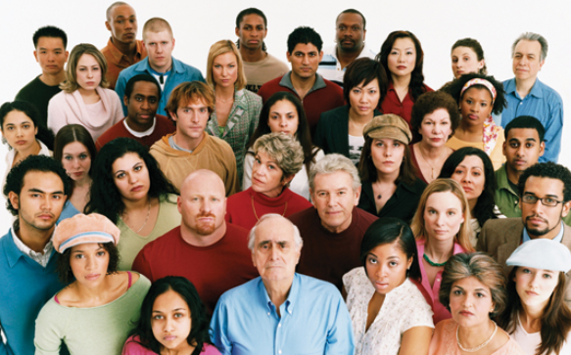
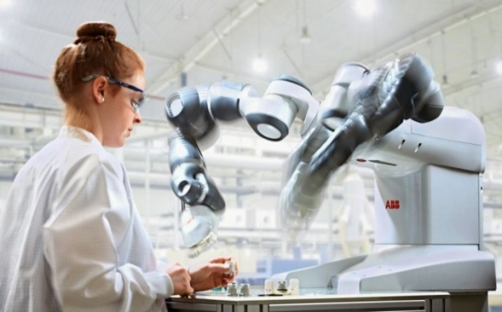

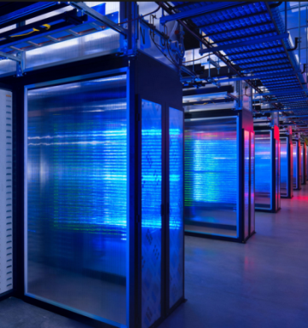
Multi-agent Computational Economy
Increasing presence of computational agents
Human-Human Economy
Human-Machine Collaboration
Ingenuity + Analysis
M2M Economy
Challenge: economic agent behavior modeling
Human agent: maximization of self-interest, rational choice theory, game theory, the agency problem, monopolies, cartels, and cronyism
Computational agent behavior: externalities, complexities, interrelations even if open code
Industries of the Future:
Machine Ethics, and Modeling of Computational Economic Agent Behavior

Slide 32

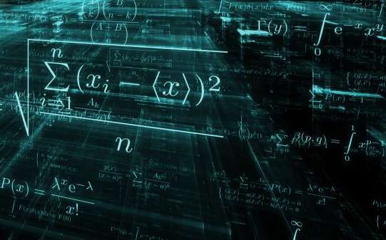
Economics: Basic Design Principles
Economic Principles
Traditional Deployment
Markets
Blockchain Deployment
Any interaction is a discovery and exchange process
Abundance mindset and overcoming scarcity
Decentralized models supplement hierarchy
Demurrage incitatory potential and resource redistribution across network nodes
Reciprocal mining communities
Blockchain technology is prompting us to rethink economic principles in markets, and apply them much more extensibly to other situations in a non-monetary sense

Slide 33
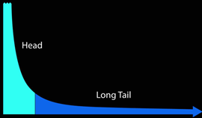

Reinventing Economics and Government
Long Tail premise
80/20 rule false in digital markets
Sell less quantity of more items
Look at the long tail as a market itself
Long Tail Effect
Analysis (Brynjolfsson et al., 2006, 2010)
Amazon: niche books account for 36.7% of sales
Power laws not Pareto distributions in etailing (books, music), software downloads (70/30 not 80/20)
Critique (Elberse, 2008)
Pareto distribution not power laws in some markets
Evolving market: feedback effect of online reviews
Key point: personal preference markets work
2006
Source: Anderson; Brynjolfsson; Elberse

Slide 34



Long Tail Financial & Government Services
One size does not fit all
Any two parties can meet and transact on a blockchain
Long Tail Systems
One size fits all
Personalized
Rethink debt with small-chunk capital
Long Tail financial services
“Amazon or eBay of money”
Personalized banking, credit, mortgages, securities
Long Tail governance services
“Amazon or eBay of government”
Personalized governance services, pay for consumption
Source: http://www.amazon.com/Bitcoin-Blueprint-New-World-Currency/dp/1491920491

Slide 35
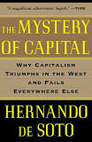

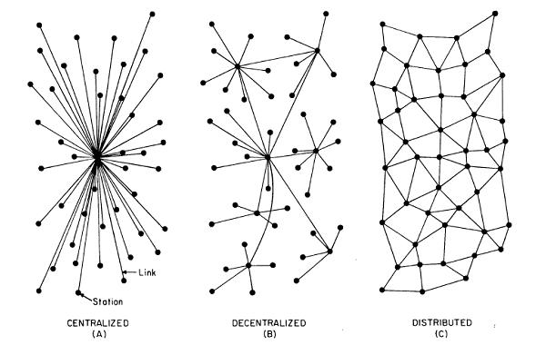
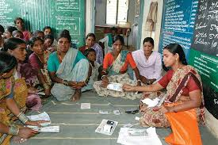
Financial Inclusion
Blockchain: leapfrog technology
2 billion under-banked
70% lack access to land registries
Need decentralized networks because hierarchy does not scale
Does not make sense to build out brick-and-mortar bank branches and medical clinics to every last mile in a world of digital services
Like cell phones, digital solutions could be the answer
eWallets and deep learning diagnostic apps for global inclusion
Source: Pricewaterhouse Coopers. 2016. The un(der)banked is FinTech's largest opportunity. DeNovo Q2 2016 FinTech ReCap and Funding ReView., Heider, Caroline, and Connelly, April. 2016. Why Land Administration Matters for Development. World Bank. http://ieg.worldbankgroup.org/blog/why-land-administration-matters-development

Slide 36


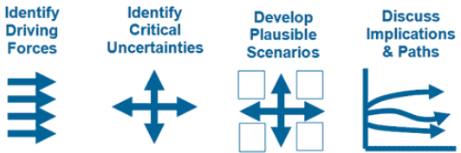
Framework for future uncertainty Blockchain Scenario Planning
Identify two biggest drivers: government regulation and rate of adoption
Assess news
Highly Regulated
B
A
Slow Adoption
Rapid Adoption
Unregulated
Source: GBN Scenario Planning technique

Slide 37
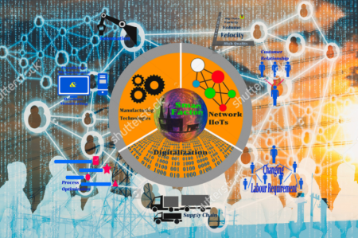
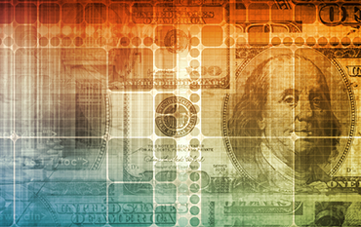
Economics and Finance
Systems for organizing access to resources
Economics
Past, Present
Finance
Future
Time
Cryptocurrencies: Spot Market
Smart Contracts: Futures & Options Market

Slide 38

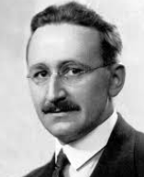
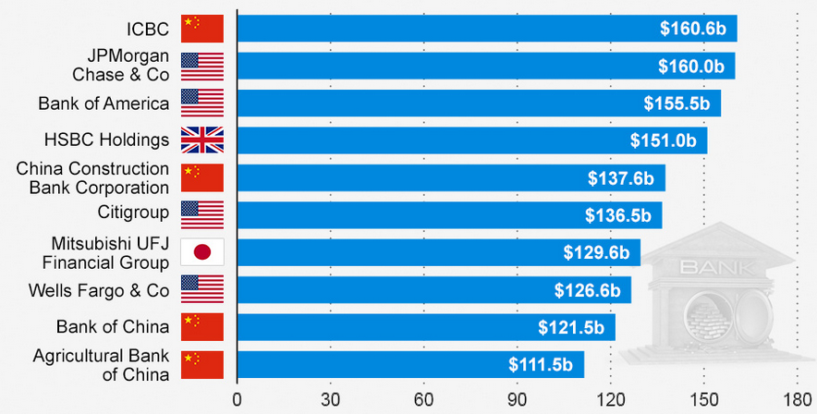
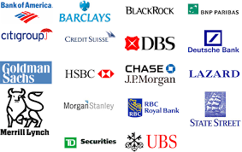

Hayek: Financial Institution Currencies
“Multiple private currencies should compete for customer business”
- Friedrich Hayek
Top Global Banks based on Tier 1 Capital (2014)
Top Investment Banks
Source: Hayek, F. The De Nationalization of Money. 1976. (paraphrased); https://www.statista.com/topics/1552/banks-in-china
Tier 1 Capital: equity capital + disclosed reserves (measure of banking strength)

Slide 39
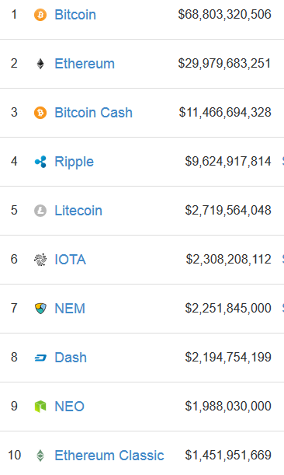
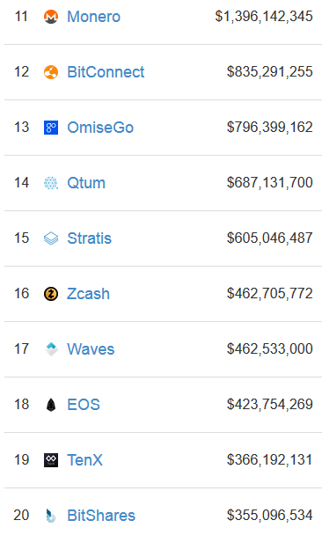
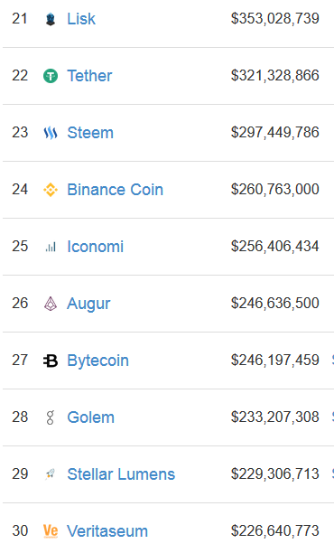
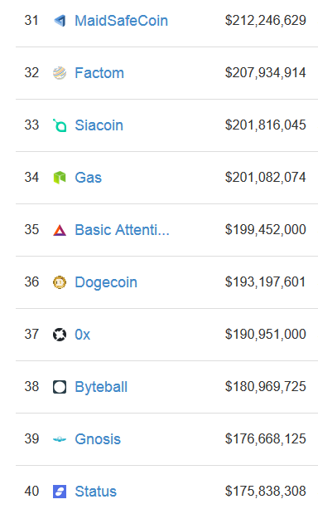
New Economic World Order
Not just cryptofinance, every company own coin issue
Cryptocurrencies and storage, banking, healthcare, financial services, technology platforms, fundraising firms
Source: https://bitcoinmagazine.com/articles/op-ed-blockchain-economy-ushering-new-world-economic-order

Slide 40







Securities as a Service
Asset
CD, DVD
Auto, Home
Securities
Streaming Music and Video Services
Uber, Lyft, Gett, Juno, Via; Airbnb, VRBO HomeAway
Consumable benefits of securities: cash flow, appreciation
Service
Entertainment as a Service
Transportation, Domicile as a Service
Securities as a Service
Securities a Service
Now have to own because uncertain future value of assets
Access to the consumable benefits of the asset without owning
Works if trust consumable assets will have future availability
Need the cash flow the asset provides, not the asset itself
Source: Blockchain Fintech: Programmable Risk and Securities as a Service, http://futurememes.blogspot.com/2016/10/blockchain-fintech-programmable-risk.html

Slide 41











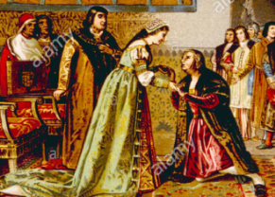
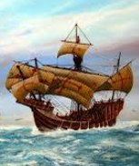





Future of Institutions
Role: organize life and manage contention
Influence persists but more choice about belonging
Historical
Contemporary
Future
Building
Building - Website
Building – Website – Credential
Bank
Government
Police
Church
Crown
Farther Future
DMV
Healthcare
Academia
Data pillars: library of all society’s memory and public records
Columbus’s VCs: Ferdinand and Isabella
Corporation
Church
Law

Slide 42





Future of Nation States
Regulatory Arbitrage and Crypto-Specialization
DE-based C corporations
Swiss & Cayman banking laws
Estonia eResidency Program
Gibraltar DLT Registered Entities (ICO response)
Malta online casinos & Bitcoin
Transnational boundaries
ICANN & decentralized DNS/ENS
Namecoin (.bit domains)
Ether (.eth domains)
Human Rights, Refugees

Slide 43

Blockchain Economic Theory
Production, distribution, and consumption of goods and services in a Blockchain Economy…
Same as a Classical Economy
Underlying dynamics do not change: wants outweigh resources, cost to decisions, scarcity of valued resources
Institutions, Money, Nation States persist, change in form
Assets, identity, & information now become cryptographic
Different than a Classical Economy
Hybrid economy of human and computational agents
Leapfrog technology: financial inclusion and rethink debt
New economic design principles: long tail, decentralization, assets as a service, smart contracts
Source: http://blockchainstudies.org/Blockchain_Economics_CFP.pdf

Slide 44




Blockchain Economic Theory
Elements of Economic Theory |  | Not Changing | Changing
Basic Definition
 | Production, distribution, consumption of goods and services | X
 | Individual and group decision-making and consequences | X
 | Wants exceed resources, opportunity cost, scarcity | X
 | Shift: material goods to intangible goods and services |  | X
Employment
 | Technological Unemployment (Automation Economy) |  | X
 | Multi-Agent Economy (Computational Agents) |  | X
Institutions and Nation States
 | Role and Influence | X
 | Form and Choice about Joining |  | X
Money, Capital, and Debt
 | Importance and Role | X
 | Form and Access |  | X
Principles
 | Long Tail Markets (Personalized Services) |  | X
 | Decentralization/Financial Inclusion |  | X
 | Drivers: Regulation and Technology Adoption | X
 | Time Frame Focus: Present to Future |  | X
Source: http://blockchainstudies.org/Blockchain_Economics_CFP.pdf

Slide 45
Agenda
Introduction
Technical Overview
Blockchain ICOs
Blockchain Economic Theory
Why do we need Blockchain?
Big health data, global energy markets, risk modeling, space, financial inclusion
Smart Network Convergence
Blockchain and Deep Learning

Slide 46






Why is blockchain DLT needed? Larger Scale Tiers of Projects
The reason blockchain is needed is to work on the next larger slate of challenges
Key features: secure value transfer, automation, trackability
Future Projects
Next Projects
Current Projects
Kardashev scaling
Previous Projects
Medicine, Energy, Risk, Poverty
Space settlement
Energy farms, global comms. networks
Deep Learning Chains
Railroads, steam engines, interstate roads
Blockchain
Internet
Key Enabling Technology
Telegraph

Slide 47


Medicine: Big Health Data
Lack understanding of many biological mechanisms of disease and prevention
Population
7.5 bn people worldwide
Source: https://www.illumina.com/science/technology/next-generation-sequencing.html

Slide 48






Global Energy production, storage, transmission
Vast market for secure coordination
Growth 1971-2012
Estimated Demand 2035
Source: http://www.ichorcoal.com/our-business/market-research, https://archinect.com/news/article/137952923/animated-3d-data-maps-of-new-york-city-beyond

Slide 49




Global Risk Modeling

Slide 50


Smart City Modeling & Simulation
Data provenance, secure sharing, auditability
Uber Pick-ups (Apr-Sep 2014)
Building Age

Slide 51




Space: Mining, Energy, Settlement
Secure automated systems for:
Minerals and Energy
Asteroid mining
Space-based energy production
Habitat management
Settlement, tourism, terraforming
Launch and communications
Payload, small rockets, cargo drops, microstats, construction materials
Astronomical observation and experimentation
Debris monitoring and notification
Source: Blockchain Singularities :http://www.slideshare.net/lablogga/blockchain-singularities-65443340

Slide 52
Agenda
Introduction
Technical Overview
Blockchain ICOs
Blockchain Economic Theory
Why do we need Blockchain?
Smart Network Convergence
Blockchain and Deep Learning

Slide 53


New Technology
Better horse AND new car

Slide 54

Smart Network Convergence Theory
Smart networks are computing networks with intelligence built in such that identification and transfer is performed by the network itself through protocols that automatically identify (deep learning), and validate, confirm, and route transactions (blockchain) within the network
Source: Swan, M. & de Filippi, P. (2017). Introduction, In Toward a Philosophy of Blockchain. Swan, M. & de Filippi, P., Eds. Metaphilosophy. New York: Wiley & Sons. 48(5).

Slide 55

Smart Network Convergence Theory
Two Fundamental Eras of Network Computing
Network intelligence “baked in” to smart networks
Blockchains to transfer value, confirm authenticity
Deep Learning algorithms for predictive identification
Source: Expanded from Mark Sigal, http://radar.oreilly.com/2011/10/post-pc-revolution.html

Slide 56

What is Deep Learning?
Conceptual Definition:
Deep learning is a computer program that can identify what something is
Technical Definition:
Deep learning is a class of machine learning algorithms in the form of a neural network that uses a cascade of layers (tiers) of processing units to extract features from data and make predictive guesses about new data
Source: Swan, M., (2017)., Philosophy of Deep Learning, https://www.slideshare.net/lablogga/deep-learning-explained

Slide 57




Next Phase
Put Deep Learning systems on the Internet
Need blockchain registration, security, and audit tracking
Immediate Application: Autonomous Driving
Smart networks: deep learning + blockchain
Deep Learning: identify what things are
Blockchain: secure automation technology
Track arbitrarily-many units, audit, upgrade
Legal liability, accountability, remuneration

Slide 58
Agenda
Introduction
Technical Overview
Blockchain ICOs
Blockchain Economic Theory
Why do we need Blockchain?
Smart Network Convergence
Blockchain and Deep Learning

Slide 59



Blockchain Strategies Opportunity: Low-hanging Fruit
Information confirmation, not monetary transfer:
Cryptographic asset registries
Investor information services
Supply chain, logistics
CRM, Business Logic
Energy quoting, transmission
Automate administrative steps
Stock Transaction
Steps with human decision-making
Real Estate Purchase/Sale
Health Insurance Billing
Energy Contract
Steps that can be automated with blockchain
Supply Chain Shipment

Slide 60


Blockchain Strategies Opportunity: Cryptographic Registries
Asset Registries
Land, auto, home titles
Stocks, bonds, insurance
Sales quotes, RFP
Public Documents
Driver’s license, permit
Business registration
Regulatory & QA compliance
Diploma, credential
Passport, identity document
Voter registration, census
Birth and death certificates
Illinois, Arizona, Delaware, Idaho
Finland, Dubai, Georgia, Estonia, Sweden, Denmark

Slide 61



Blockchain Strategies Opportunity: Leadership Edge
Start or join industry consortium
Implement digital ledgers
Automate transfer of money, assets, bids, quotes, RFPs, ERP, supply chain
Value chain process mapping
Revenue-generating
Offer blockchain-based services to clients
Example: banks targeting larger customer base through blockchain-based eWallet solutions
Cost-saving
Finance, treasury, accounting, GL/AR/AP
Quality assurance, regulation, compliance, audit functions
Source: http://www.amazon.com/Bitcoin-Blueprint-New-World-Currency/dp/1491920491

Slide 62





Conclusion
Blockchain is a fundamental information technology for secure value transfer over networks
For any asset registered in a cryptographic ledger, the Internet is a VPN for its confirmation, assurity, and transfer
Reinvent economics and government for the digital age
Long tail structure of digital networks allows personalized services
Long Tail Systems
One size fits all
Personalized

Slide 63


Conclusion (continued)
A technology like blockchain is needed to work on next-generation challenges
Financial inclusion, big health data, global energy markets, and space
Smart networks: a new form of automated global infrastructure
Identify (deep learning)
Validate, confirm, and route transactions (blockchain)

Slide 64








The Farther Future Swan’s Theory of Computation
Basic physics discovery drives computation paradigms
Gravity: emergent space, time, geometry & dynamics
Scale
Physics Discovery
Computation Device
Newton
(1687)
Difference Engine
(1786)
Classical scale
(1×10¹)
Quantum Mechanics
(1905)
Transistor
(1947)
Atomic scale
(1×10⁻⁹)
Quantum Computing
Quantum Gravity
(2016)
??
(2075e)
Planck scale
(1×10⁻³⁵)
Source: “There’s plenty of room at the bottom” – Feynman; the other bottom, the Planck scale

Slide 65
7. Blockchain Economics
Melanie Swan
Philosophy Department, Purdue University
melanie@BlockchainStudies.org
Slides: http://slideshare.net/LaBlogga

Slide 66
Agenda
Definitions

Slide 67
What is a Blockchain/Distributed Ledger?
Conceptual Definition:
Blockchain is the tamper-resistant distributed ledger software underlying cryptocurrencies such as Bitcoin, for the secure transfer of money, assets, and information via the Internet without a third-party intermediary
Source: http://www.amazon.com/Bitcoin-Blueprint-New-World-Currency/dp/1491920491

Slide 68

Technical Definition What is a Distributed Ledger?
Distributed ledgers are a new form of distributed software architecture where agreements on the ‘shared state’ of decentralized and transactional data can be established in a network of untrusted and anonymous participants holding a replica of the data which is ‘append-only’ updated in chronological order through one-way hash function encryption
Source: Paolo Tasca, Executive Director, Centre for Blockchain Technologies, University College London

Slide 69
Technical Definition (continued) What is a Distributed Ledger?
Each transaction or event, before permanently recorded in the ledger, is verified by a group of participants under a pre-specified set of consensus rules
Once entered, information can never be erased as a result of the timestamp included in it
The ledger contains all the transaction history and each transaction is tamper-proof, publicly or privately auditable (traceable) and no-reversible
Thus a distributed ledger is a ‘trust machine’ with which people can share value, such as currency, directly and securely without any intermediary
Source: Paolo Tasca, Executive Director, Centre for Blockchain Technologies, University College London

Slide 70




What is a Ledger?
A file keeping track of who owns what
Double-entry bookkeeping
Korea Goryeo dynasty (918-1392)
Republic of Genoa (1340)
Marco Polo
Kublai Khan
Cash $100 $100
Assets $50 $50
Kublai Khan sells Marco Polo $10 assets
Cash $90 $110
Assets $60 $40

Slide 71

History of Ledgers
Source: https://www.coindesk.com/information/what-is-a-distributed-ledger

Slide 72
Technical Definition What is a Blockchain?
A blockchain is a type of distributed ledger technology in which confirmed and validated batches of transactions are held in blocks, and the blocks are linked (chained) in a tamper-resistant append-only chain which starts with a genesis block and where each block contains a hash of the prior block in the chain
Source: Paolo Tasca, Executive Director, Centre for Blockchain Technologies, University College London

Slide 73


Why is it called blockchain? Ledger (chain) of sequential transaction blocks
Block 10
Block 11
Block 12
Each new block starts by calling the last block, so a cryptographic chain of transactions is created
Every 10 minutes, the latest block of submitted transactions is validated (by cryptographic mining) and posted to a single distributed ledger
Source: Satoshi Nakamoto whitepaper: https://bitcoin.org/bitcoin.pdf, https://blockexplorer.com

Slide 74
Agenda
Distributed Ledger Applications

Slide 75



Key blockchain functionality
Secure information exchange
Asset confirmation and transfer
Automated coordination
Example: fleet management of drones, autonomous driving, robotics, clinical trial patients, cellular therapeutics
Blockchain: automated, secure coordination system with remuneration and tracking
Source: Swan, M. Philosophy of Social Robotics: Abundance Economics. Sociorobotics, 2016. http://www.melanieswan.com/documents/SocialRobotics.pdf.

Slide 76




Financial Services
Shared ledger
Instantaneous transaction validation (t=0, not t+3)
Settlement, clearing,
Custody, insurance
Secure, lower risk, cheaper
Financial assurity
Securities asset registries
Automated clearing
Quoting, deal placement
Billing, settlement
Shared Ledger
Source: https://www.cbinsights.com/blog/financial-services-corporate-blockchain-investments

Slide 77



Supply Chain and Logistics
$54 trillion global supply chain, $23 trillion tied up in receivables
Sweetbridge Bridgecoin cryptocurrency (US CFTC-compliant commodity)
Tamper-proof record-keeping
SKU chain PopCodes (proof of provenance codes)
Confirmation, notification, payment
Register assets and inventory
Assure provenance, custody
Track quantity and transfer of assets (pallets, trailers, containers) moving through supply chain nodes

Slide 78




Energy
Blockchain energy projects
Enerchain: trading (NE Europe)
BTL Interbit blockchain energy platform: trading (Vancouver CA)
PONTON: DSO, TSO, aggregator, generation power-balancing (Austria)
Automatic markets
“Energy Internet” - smart buildings on regional energy smartgrids
Smart resource self-pricing
Load-balancing
Source fungibility: wind, solar power
Energy price and trade validation
Sources: https://www.newscientist.com/article/2079334-blockchain-based-microgrid-gives-power-to-consumers-in-new-york, https://enerchain.ponton.de/index.php/16-gridchain-blockchain-based-process-integration-for-the-smart-grids-of-the-future

Slide 79




Healthcare
EMR (electronic medical record)
Personal health records
Users key-permission doctors to records
Digital health wallet
Identity + EMR + health insurance + payment
Health insurance billing chains
Automated claims processing
Price-quoting for medical services
Health Data Research Commons
Biobanks, QS (DNA.bits), genome files
Digital health wallet
Source: http://futurememes.blogspot.fr/2014/09/blockchain-health-remunerative-health.html

Slide 80



Politics: governance services
Blockchain weddings (Bitcoin, Ethereum)
Public document registries
Titling Registries
Local government RFPs for home, auto, land
Legal services: register and attest
Contracts, IP, agreements, wills registries
Proof of Existence: hash + timestamp + blockchain record
Voting
Quadratic voting (interest), PageRank (relevance)
Delegative democracy, random sample elections
Opt-in personalized governance services
Composting vs education
Sources: http://merkle.com/papers/DAOdemocracyDraft.pdf, http://www.proofofexistence.com/, https://bitnation.co/ , World’s First Blockchain Marriage: David Mondrus and Joyce Bayo, 10/5/14, ConsenSys wedding : Kim Jackson and Zach LeBeau, 11/2/15

Slide 81



Humanitarian
Refugee identity system
Phone access: smartphone eWallet, SMS
Object access: card, paper wallet, pendant, ring, keychain, tattoo, implantable chip
Biometric access: word phrase, fingerprint, iris, facial scan
Financial inclusion, access to learning
Smart contracts for literacy
Bitcoin MOOCs “Kiva for literacy”
Open-source FICO scores
Decentralized credit bureaus
Remittance, blockchain-tracked aid

